Slide 1

Using enhanced sampling methods for studying reactions with QM/MM
Dmitry Morozov
University of Jyväskylä, Finland
dmitry.morozov@jyu.fi

Slide 2

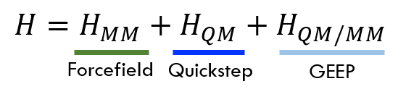

GROMACS-CP2K Interface
Quickstep: Mixed Gaussian and Plane wave basis implementation of Density Functional Theory
+
GEEP: Gaussian Expansion of Electrostatic Potential (GEEP) to compute the QM/MM coupling
MM
QM
Forcefield: Classical MM-MM interactions both bonded and non-bonded (PME)
+
Integration: Classical MD using fully periodic QM/MM forces

Slide 3
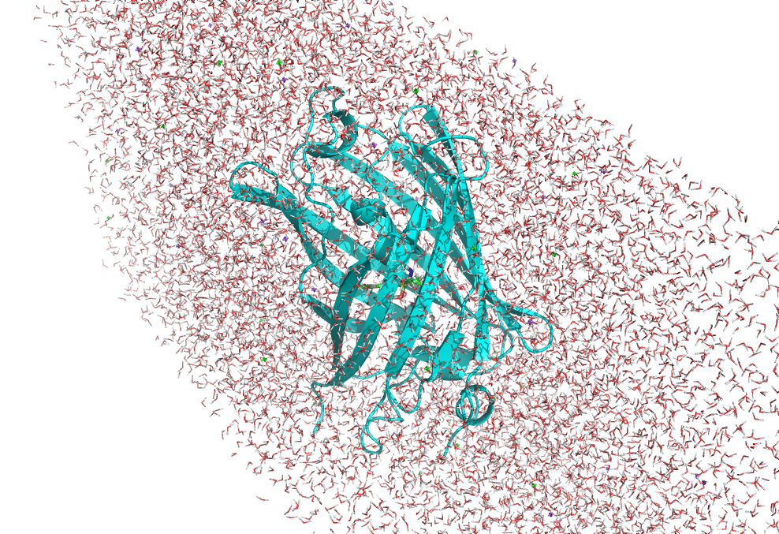
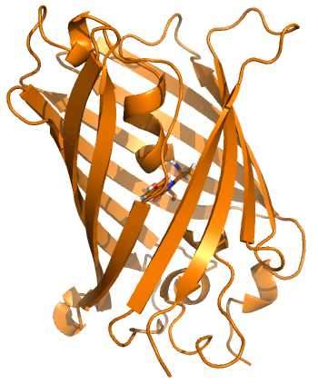
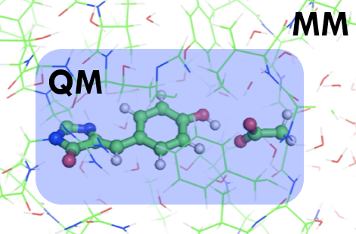
Features of the Interface
MD setup
QM/MM setup
Input protein structure
MD topology and parameters
QM/MM parameters
Automatized topology conversion from classical MD to QM/MM: charges and bonds modifications, as well as link-atoms setup on the frontier
Validated CP2K QM parameters setup for the biological systems
Compatibility with the most simulation techniques available in Gromacs
Compatibility with Gromacs tools and third-party software for analysis
Supports highly parallelizable simulation methods, like umbrella sampling

Slide 4
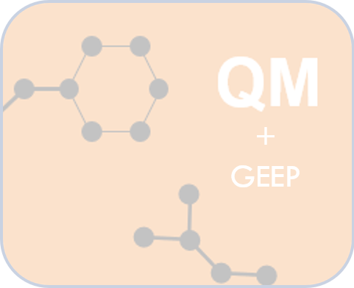
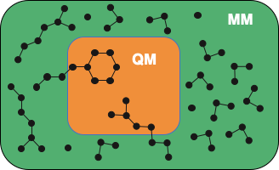
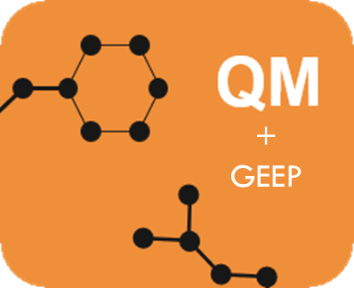
Fully periodic QM/MM
GEEP projects electrostatic potential from point charges onto the multi-grid of QM box
QM-QM periodic interactions are threated efficiently with Quickstep
Unless the QM and MM box have same dimensions the QM images over PBC will have incorrect periodicity
Blöchl scheme is used in CP2K to restore full system box periodicity
MM
Blöchl scheme
QM
De-coupling & Re-coupling
Laino, T; Mohamed, F; Laio, A; Parrinello, M. JOURNAL OF CHEMICAL THEORY AND COMPUTATION, 1 (6), 1176-1184 (2005).

Slide 5
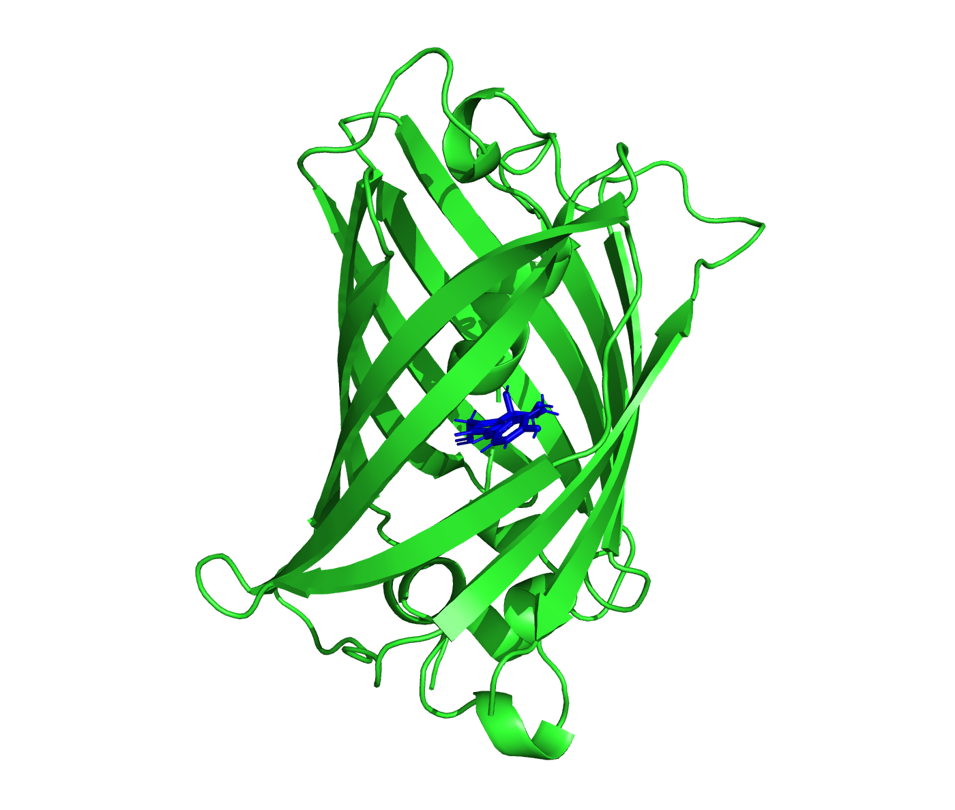
Setup a QM/MM calculation
Input structure
SYSTEM SETUP
MD SIMULATIONS
QM/MM Calculations
- Missing residues
- Residue protonation
- pdb2gmx
- Define box
- Add solvent and ions
- ….
- Prepare .mdp files
- Energy minimization
- Pressure & temperature equilibration
- Production run
…
- Index file
- .mdp parameters for QM/MM
-External CP2K input (optional)
- Geometry optimization
- Atomic charges
- QM/MM MD
- Absorption spectra
- Umbrella Sampling
- ….

Slide 6
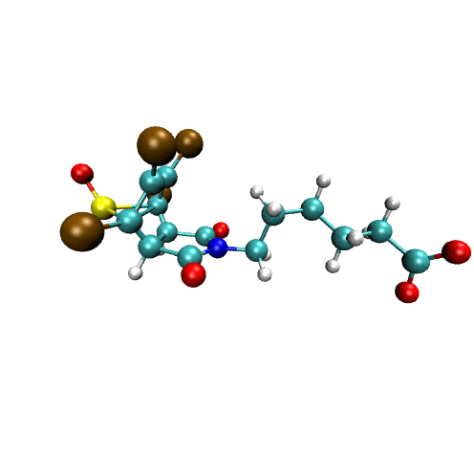
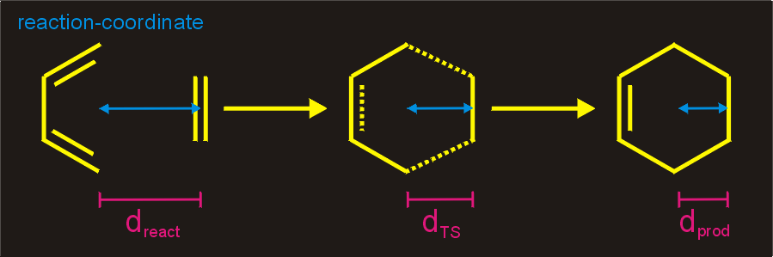
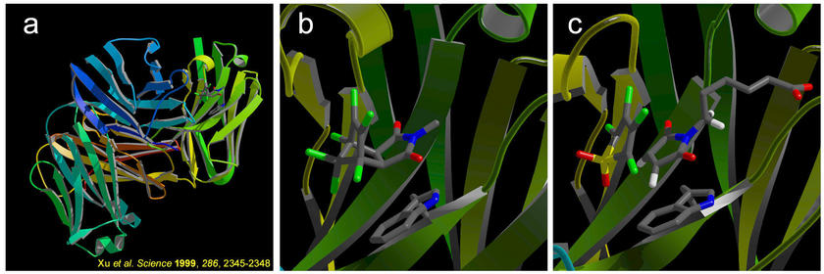
System: Diels-Alder reaction
Upon exposure to an antigen, that mimic transition state of the reaction of interest (b), the immune system generates immunoglobins that can bind the antigen (a) and thereby make it harmless. This natural immune response can be exploited to generate so-called antibody catalysts for chemical reactions (c).

Slide 7
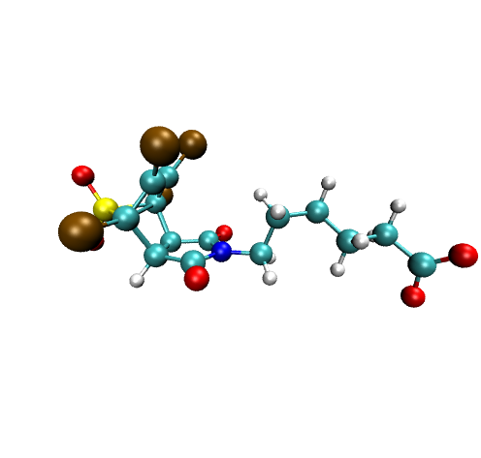
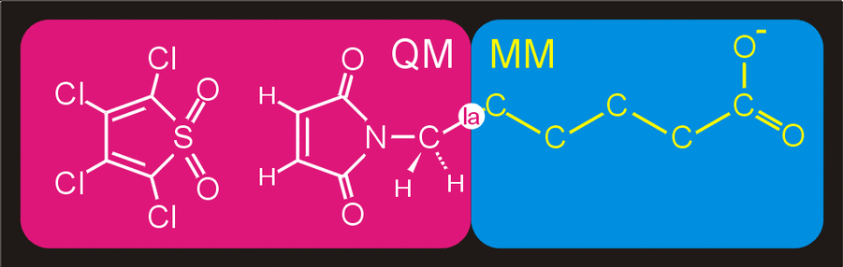
MDP Parameters for QM/MM
qmmm-cp2k-active = true
qmmm-cp2k-qmgroup = QMatoms
qmmm-cp2k-qmmethod = PBE
qmmm-cp2k-qmcharge = 0
qmmm-cp2k-qmmultiplicity = 1

Slide 8
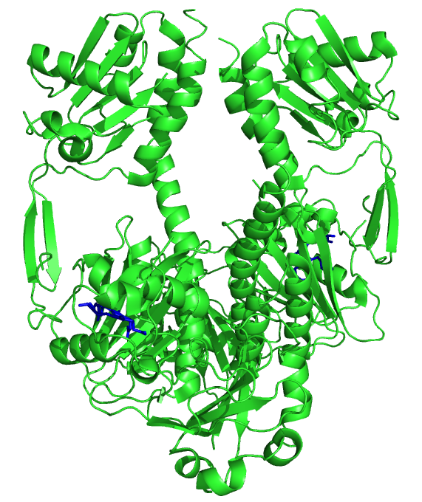
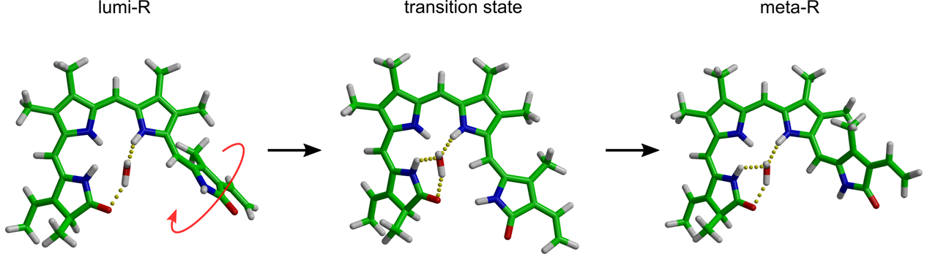
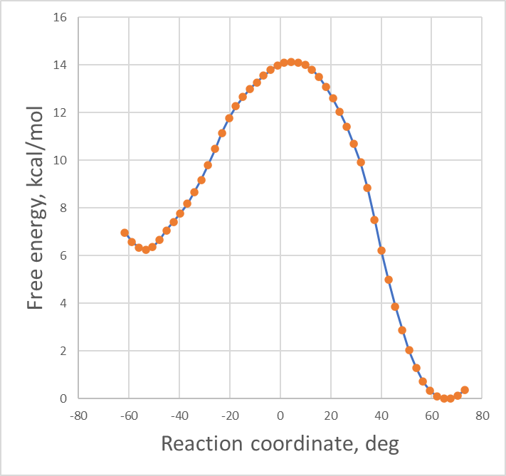
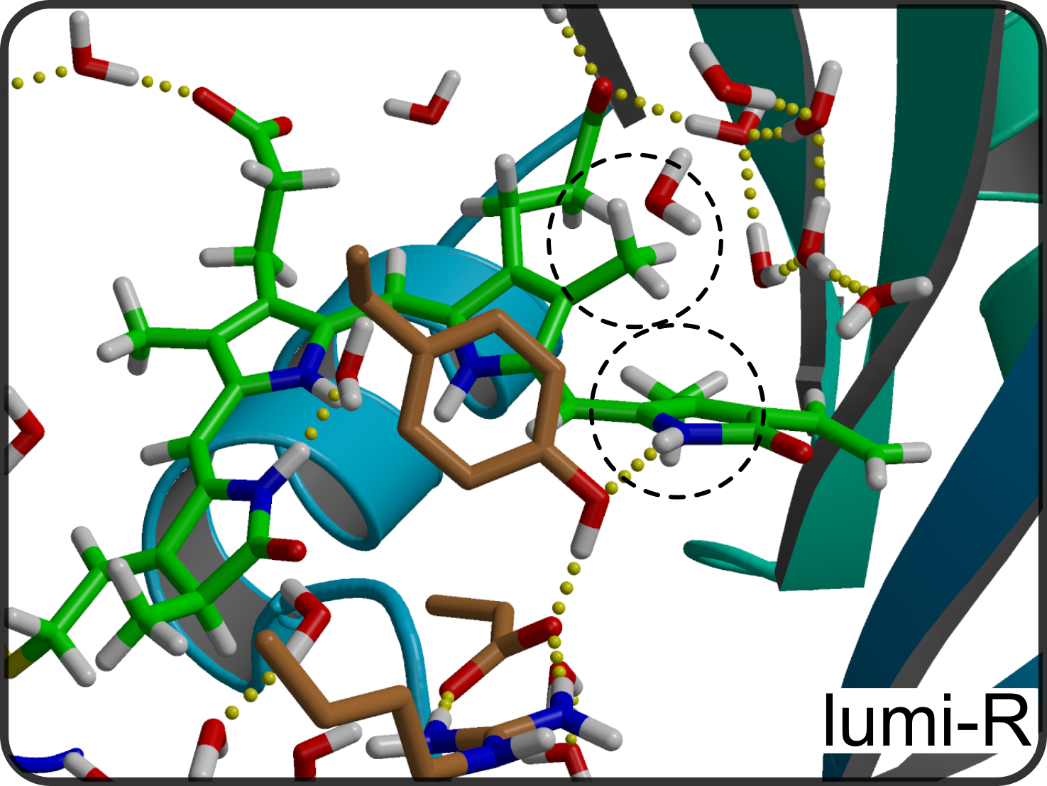
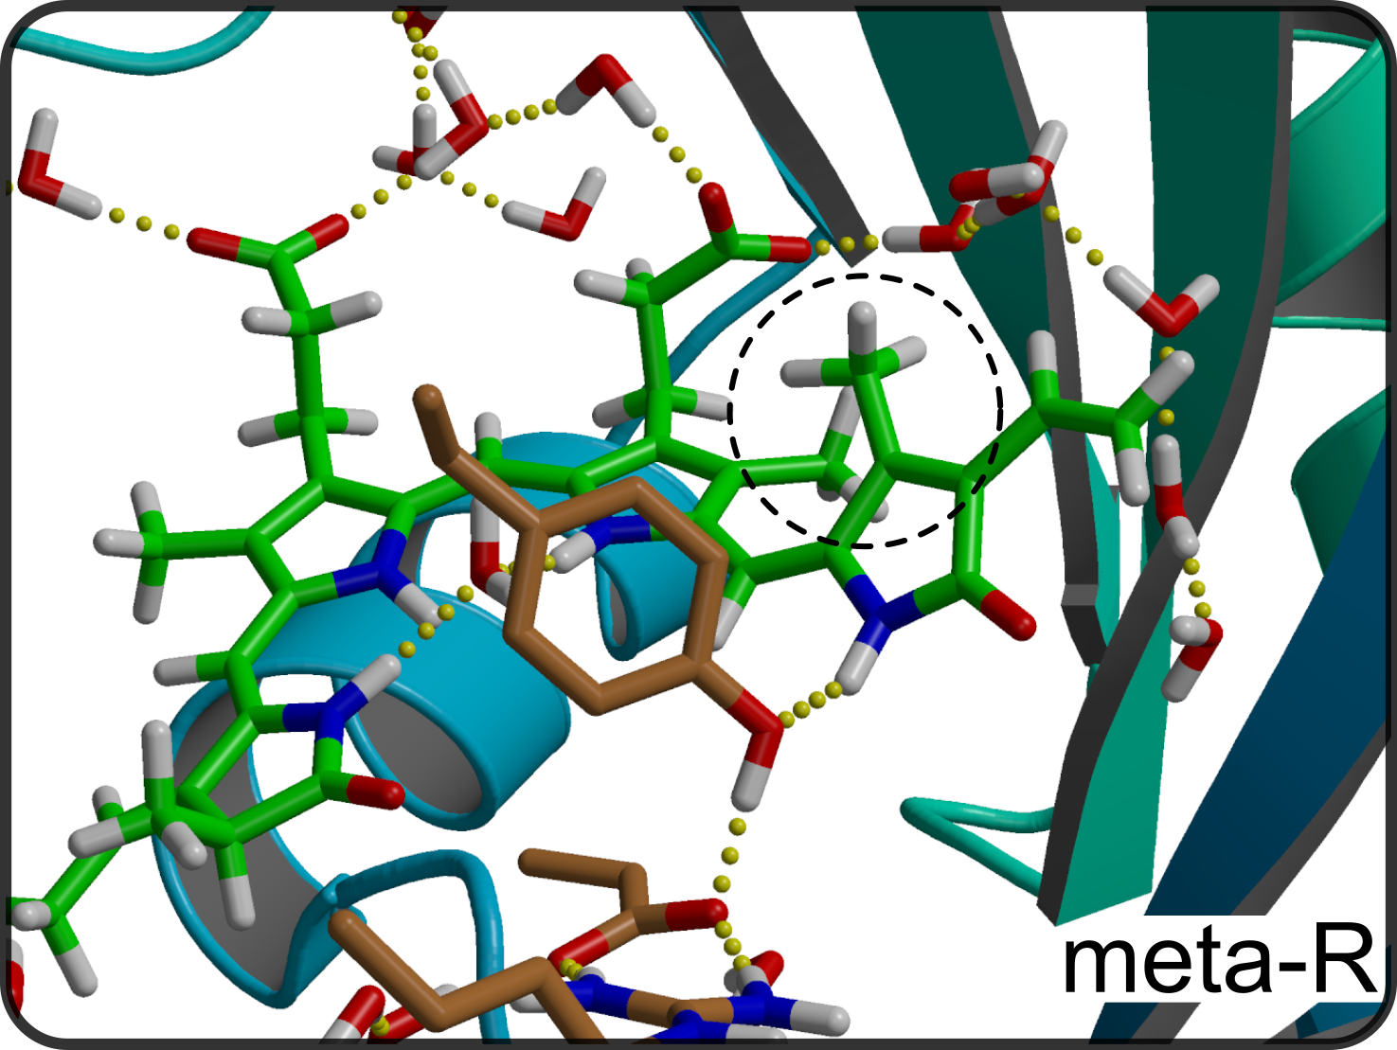
Discovering reactions with QM/MM
Isomerization of chromophore is a critical activation step in photoreceptor proteins
D-ring disposition from αf to βf in order of μs

Slide 9
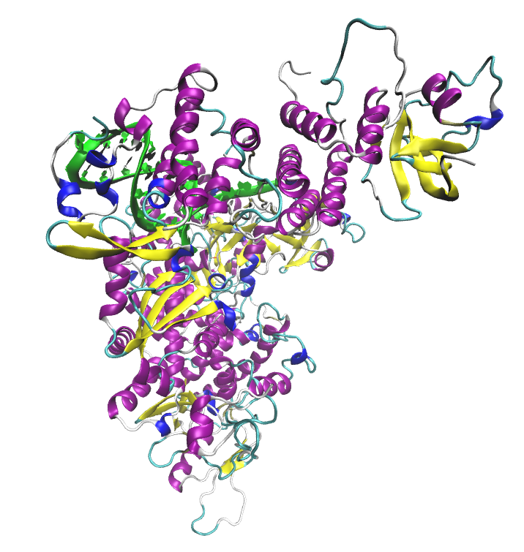
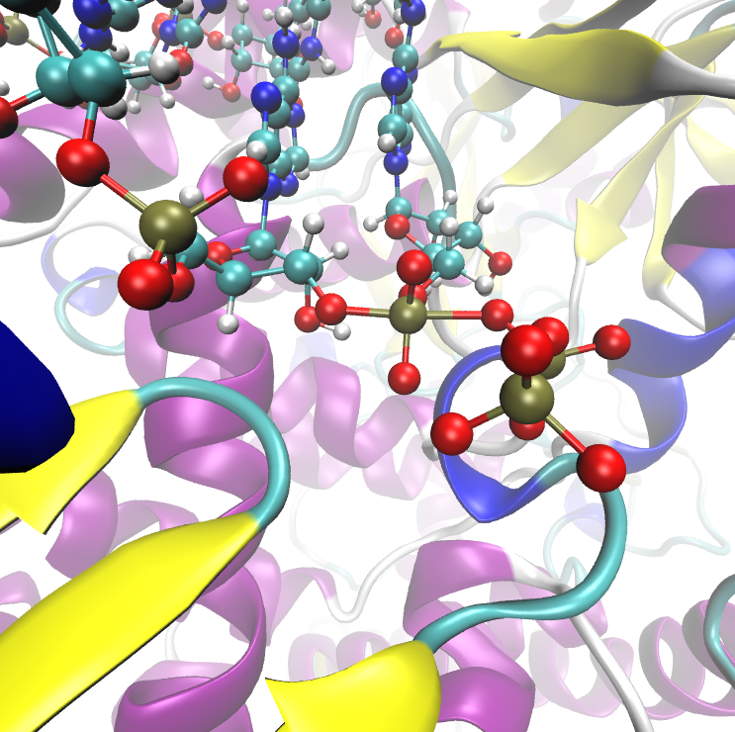
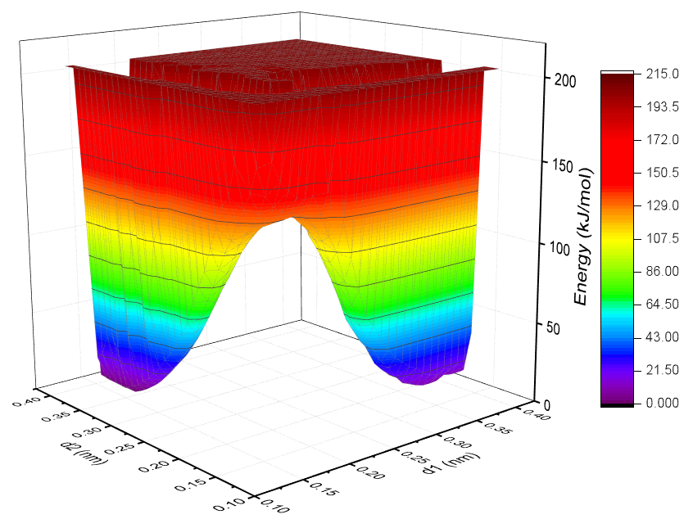
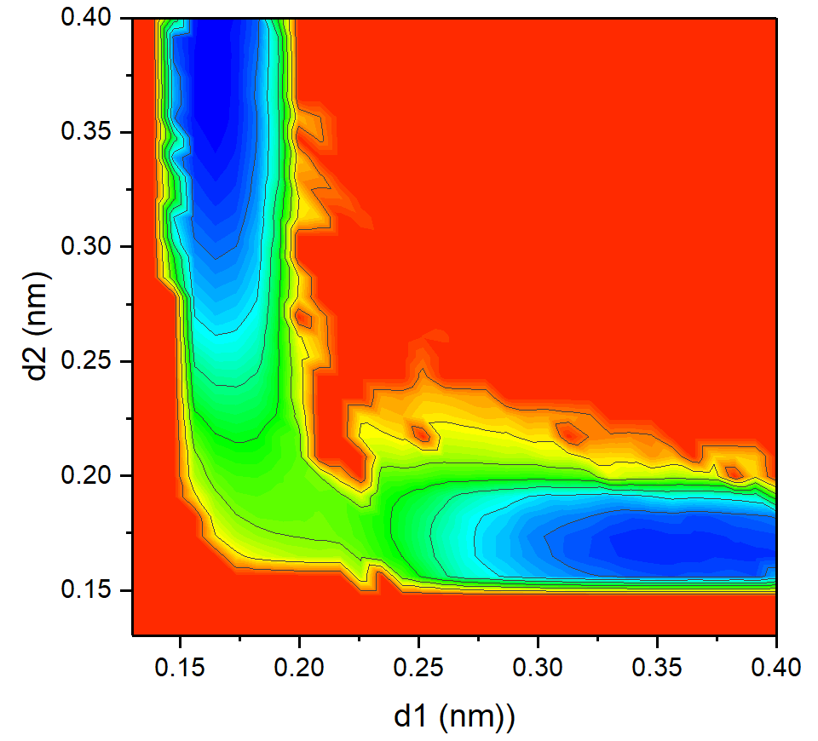
Protein simulations: using complex reaction coordinates
RNA-dependent-RNA-polymerase (RdRp) of SARS-CoV-2 virus
Ensemble NVT (300K), 1 fs timestep
10 ps equilibration
AWH with 6 walkers each ~40 ps production run
~7 days (6 ps/day) using 12 nodes (2 per walker) on Mahti
Reaction coordinate is complex combination of:
d1 = P – O3’ atom of previous nucleotide
d2 = P – O3a atom of ATP
products
d1
d2
reagents

Slide 10
Tips for efficient AWH sampling with QM/MM
1. Use awh1-target = cut-off and set awh1-target-cutoff at least twice higher than expected barrier value.
2. Use awh1-dim1-start and awh1-dim1-end a bit wider than expected product and reagent minima.
3. If you observe that simulation stuck in products/reagents minima, reaching awh1-target-cutoff, then your setup AWH is not able to pull system over the barrier and awh1-dim1-force-constant should be increased.
4. If you see problems with SCF convergence, then most probably you are trying too push the system too hard out of equilibrium. Decreasing awh1-dim1-diffusion could help to solve that.
5. QM/MM AWH simulations benefit from using multiwalker AWH (awh-share-multisim = yes and awh1-share-group = 1).

Slide 11
1) CP2K parameters and best practices:
Further information
https://docs.bioexcel.eu/qmmm_bpg/en/main/
2) Best practices in QM/MM webinar series:
https://bioexcel.eu/events/virtual-workshop-best-practices-in-qm-mm-simulation-of-biomolecular-systems/
3) Bioexcel YouTube channel:
https://www.youtube.com/c/BioExcelCoE/videos

